Slide 1

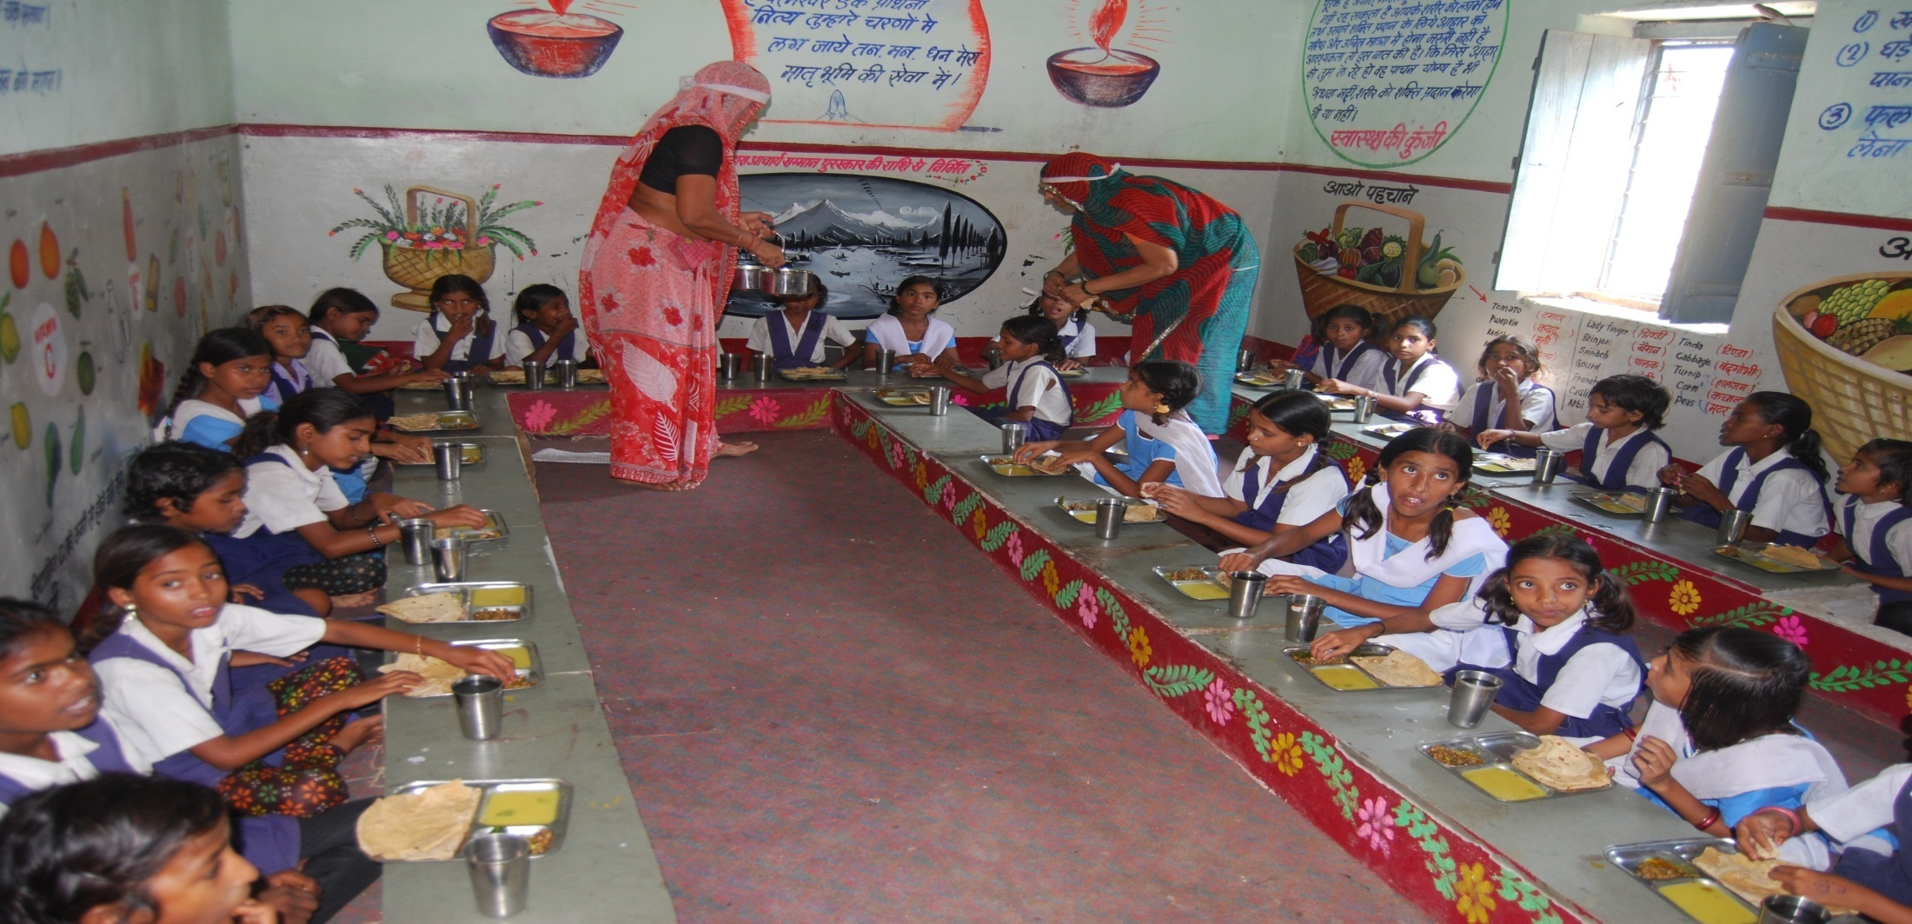
Mid Day Meal Scheme
Government of Madhya Pradesh
Government of Madhya Pradesh
Panchayat & Rural Development Department

Slide 2
Plan Approval by SSMC
Government of Madhya Pradesh
State Steering cum Monitoring Committee, in its Meeting (SSMC) held on 20 May 2019, has duly approved Annual Work Plan & Budget for 2019-20 .

Slide 3
No. of institutions year 2018-19
Government of Madhya Pradesh

Slide 4
Working Days
(April 2018 to March. 2019)
Government of Madhya Pradesh

Slide 5
Coverage against Enrollment
(April 2018 to March. 2019)
Government of Madhya Pradesh
(In Lakh)

Slide 6
Coverage against PAB approval
(April 2018 to March. 2019)
Government of Madhya Pradesh
(In Lakh)

Slide 7

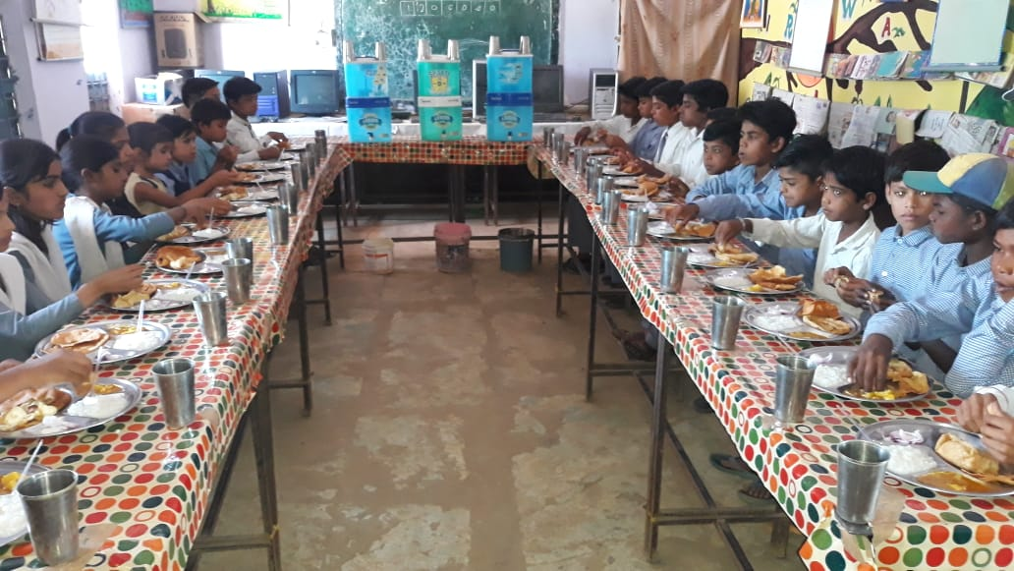
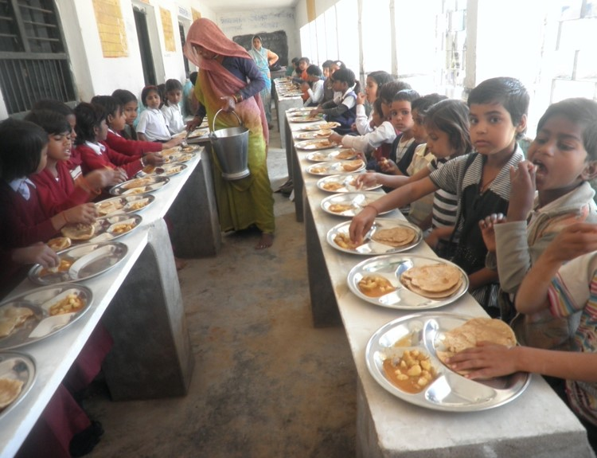
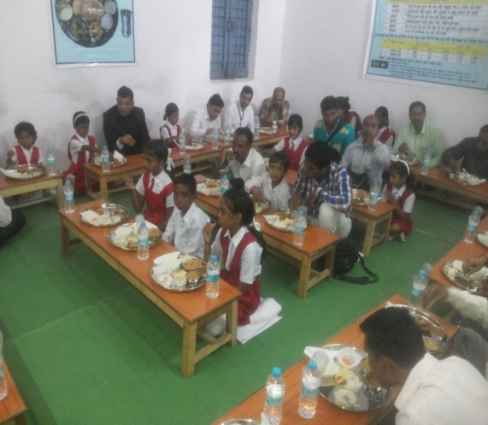
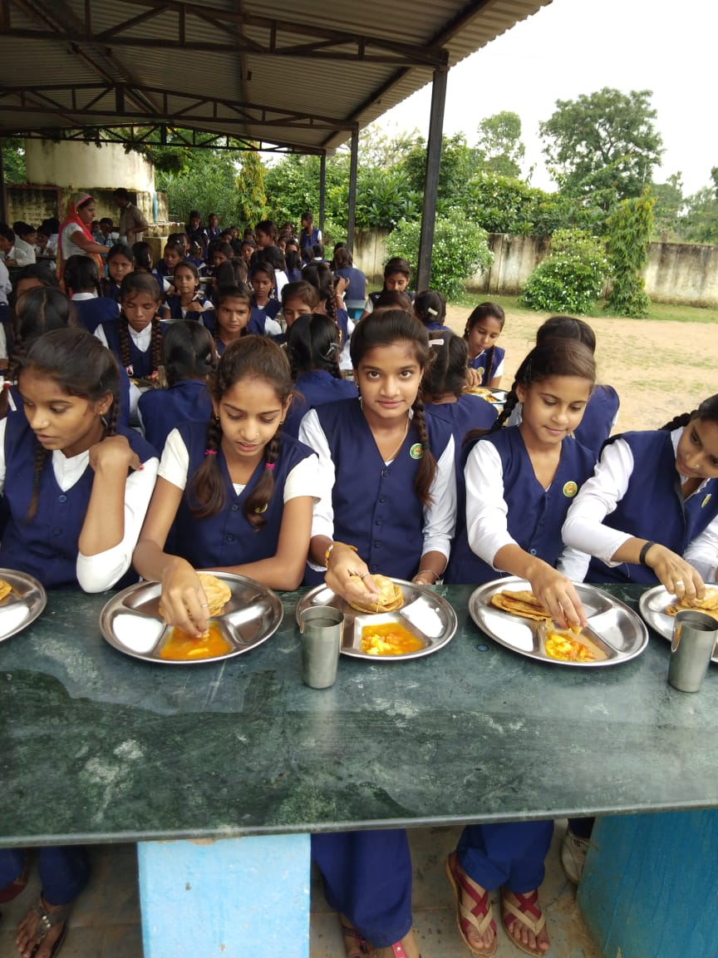
Serving MDM
Government of Madhya Pradesh
District -Neemuch

Slide 8
Food Grains Lifting & Utilisation
(April 2018 to March. 2019)
Government of Madhya Pradesh
(Qty. In MTs)

Slide 9
Cost of Food Grains
Government of Madhya Pradesh
(In Cr)

Slide 10
Cooking Cost Utilisation
(April 2018 to March. 2019)
Government of Madhya Pradesh
(In Cr)

Slide 11
CCH – Engagement
(April 2018 to March. 2019)
Government of Madhya Pradesh

Slide 12
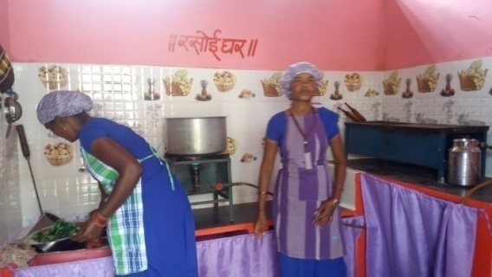
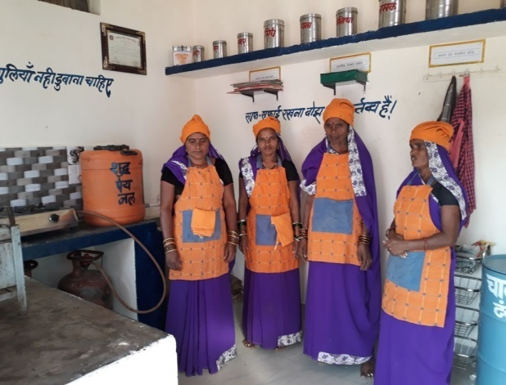
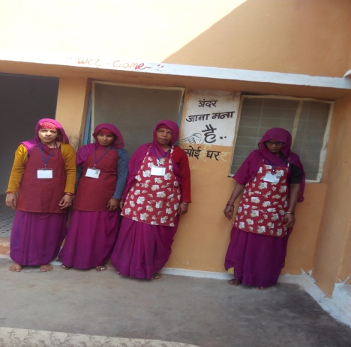
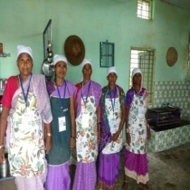
Cook Cum Helpers
Government of Madhya Pradesh
District – Vidisha and Chhindwara

Slide 13
Honorarium of Cook-Cum-Helper
(April 2018 to March. 2019)
Government of Madhya Pradesh
(In Cr)

Slide 14
TA- Utilization
(April 2018 to March. 2019)
Government of Madhya Pradesh
(In Cr)

Slide 15
MME- Utilization
(April 2018 to March, 2019)
Government of Madhya Pradesh
(In Cr)

Slide 16
Government of Madhya Pradesh
Kitchen Cum Store

Slide 17
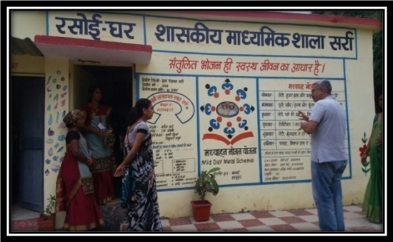
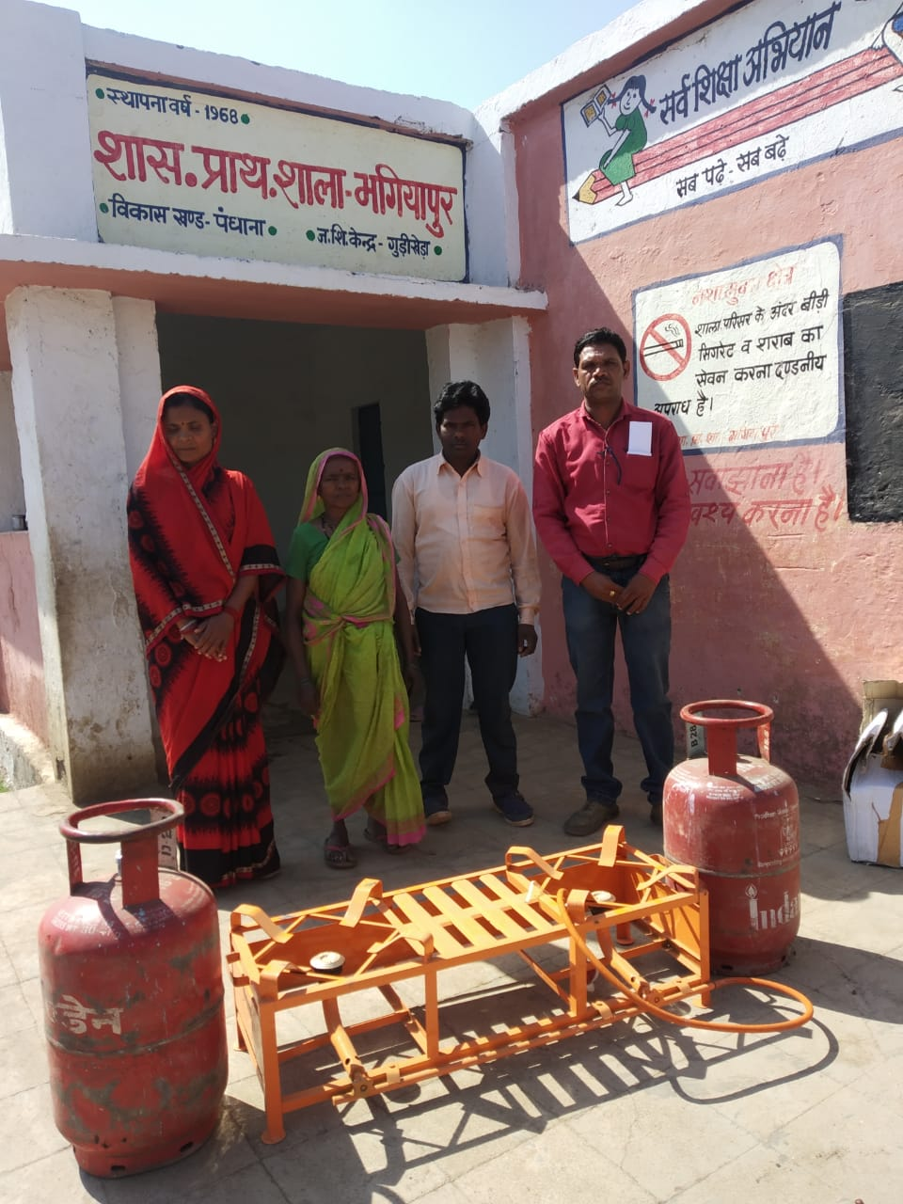
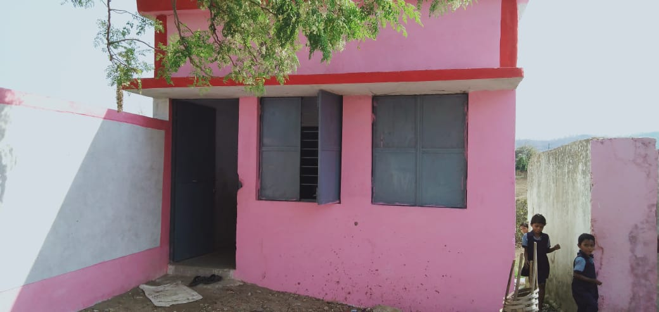
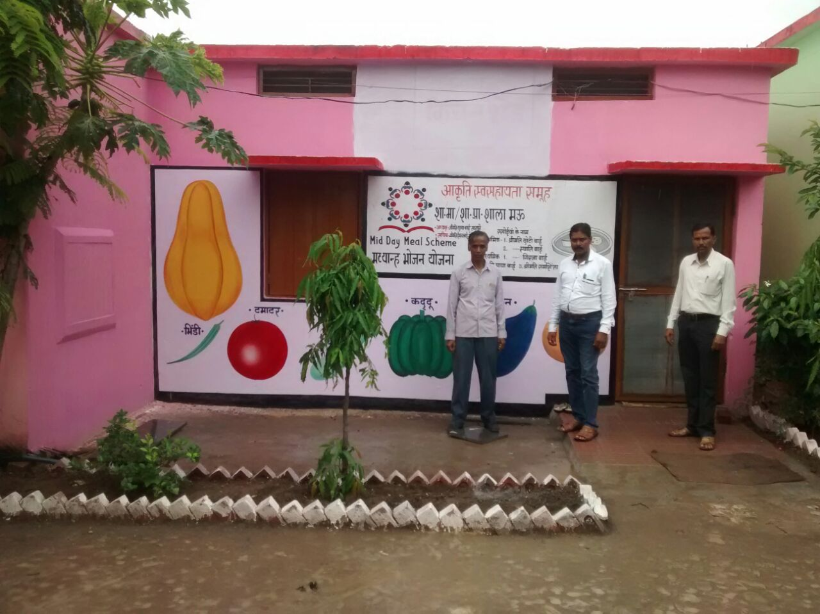
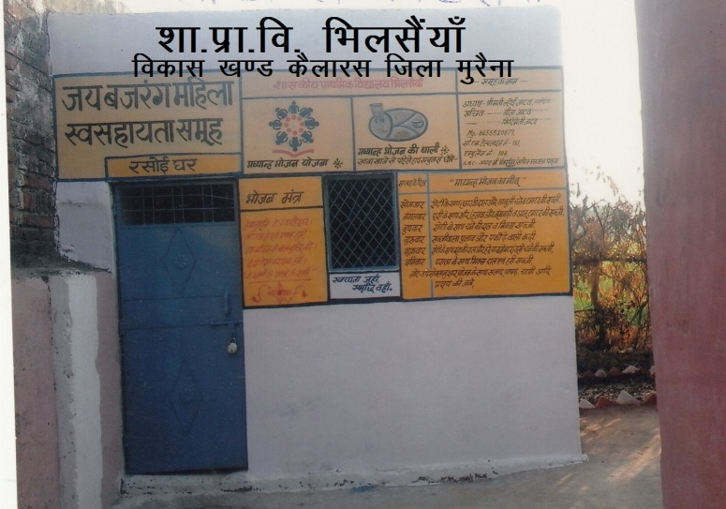
Kitchen shed
Government of Madhya Pradesh

Slide 18
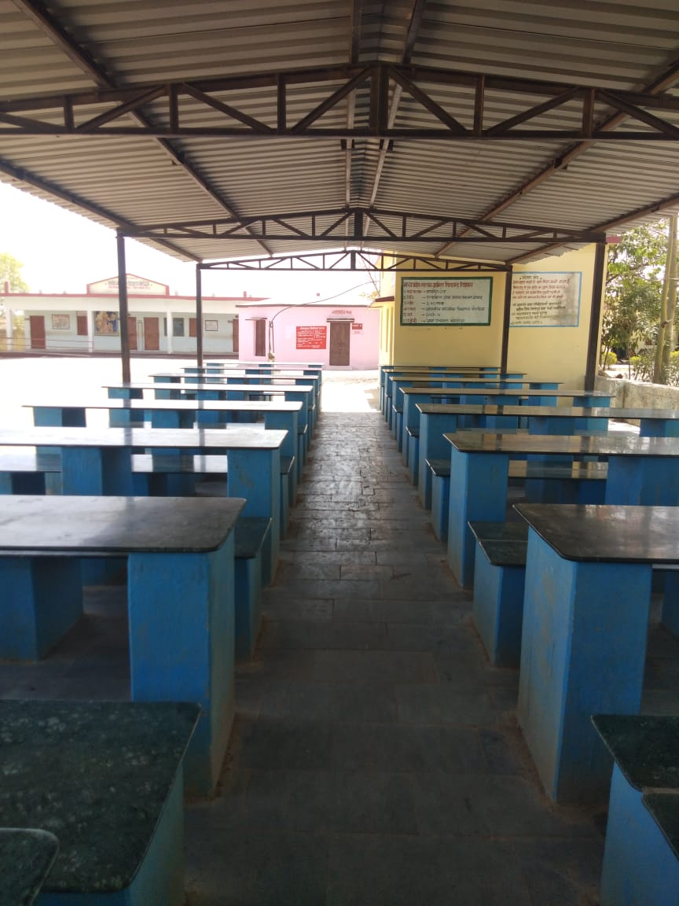
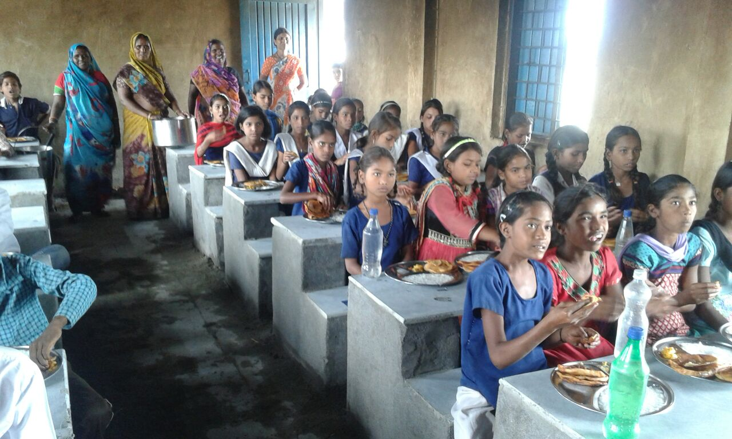
Dining hall
Government of Madhya Pradesh
Built under Panch-parmeshwar scheme
District –Neemuch

Slide 19
Annual and Monthly Data Entry for F.Y. 2018-19
Government of Madhya Pradesh
Annual MIS
Monthly MIS

Slide 20
Government of Madhya Pradesh
Automated Monitoring System has been operationalised
13 districts have successfully ported their data on mdmhp.nic.in portal.
MDM Scheme is being implemented through http://mdm.mp.gov.in MDM Portal.
School Education Department have launched M-Shiksha Mitra App for Monitoring teachers and students attendance .

Slide 21
Government of Madhya Pradesh
State MDM Portal
The MDM Scheme is being implemented through MDM Portal created with the help of NIC, Bhopal
Cooking cost to SHG and honorarium to CCH is being electronically transferred to their respective bank accounts
Food grain is being allotted to SHG’s /Agencies through eRO. Food grain is calculated school wise and sent to the government fair price shops (PDS) mapped with the concerned schools through NAN Portal

Slide 22
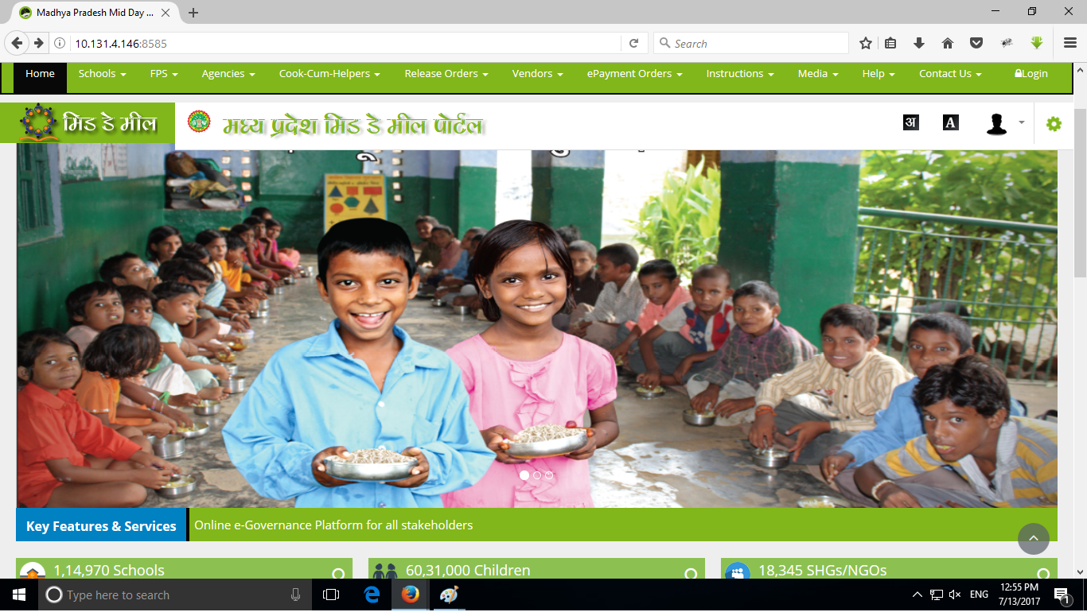
Government of Madhya Pradesh
State MDM Portal
Website - http://mdm.mp.gov.in

Slide 23
Proposal for the year 2019-20
Government of Madhya Pradesh

Slide 24
Number of Schools
Government of Madhya Pradesh

Slide 25
Coverage of Students
Working Days

Slide 26
Government of Madhya Pradesh
Requirement of Food Grain (In Mts)
Requirement of Cost of Food Grain (In Lakhs)

Slide 27
Government of Madhya Pradesh
Requirement of Cooking Cost (In Lakhs)
Requirement of Transportation Assistance (In Lakhs)

Slide 28
Requirement of CCH and their Honorarium
Government of Madhya Pradesh

Slide 29
Government of Madhya Pradesh
Requirement of Kitchen Cum Store
Requirement of Kitchen Devices & Replacement

Slide 30
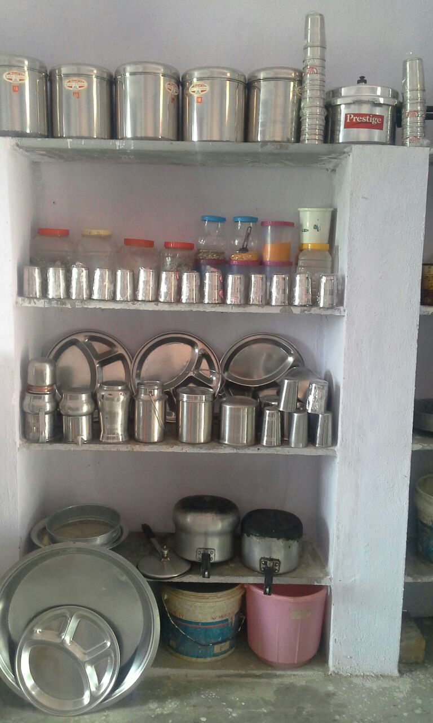
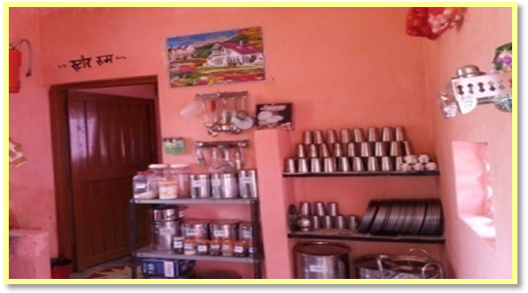
Kitchen Devices
Government of Madhya Pradesh
District -Chhindwara

Slide 31
Proposal For 2019-20
(Primary & Upper Primary)
Government of Madhya Pradesh
(In Lakh)

Slide 32
Flexi fund
Government of Madhya Pradesh
Expected Allocation Rs. 64.98 Cr
Proposed activities
    Nutrition Kitchen Gardens
    Additional Nutrition to students of 75 blocks identified by State Public Health and Family Welfare Department with poor Composite Health and Nutrition Index .
    Distribution of Chikki made out of ground nut and jaggery by NRLM compliant SHGs .

Slide 33
Flexi fund
Government of Madhya Pradesh
Distribution of Chikki

Slide 34
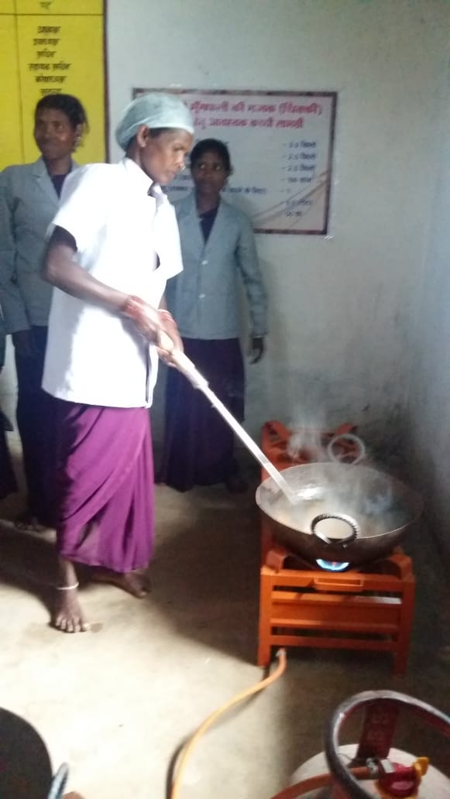
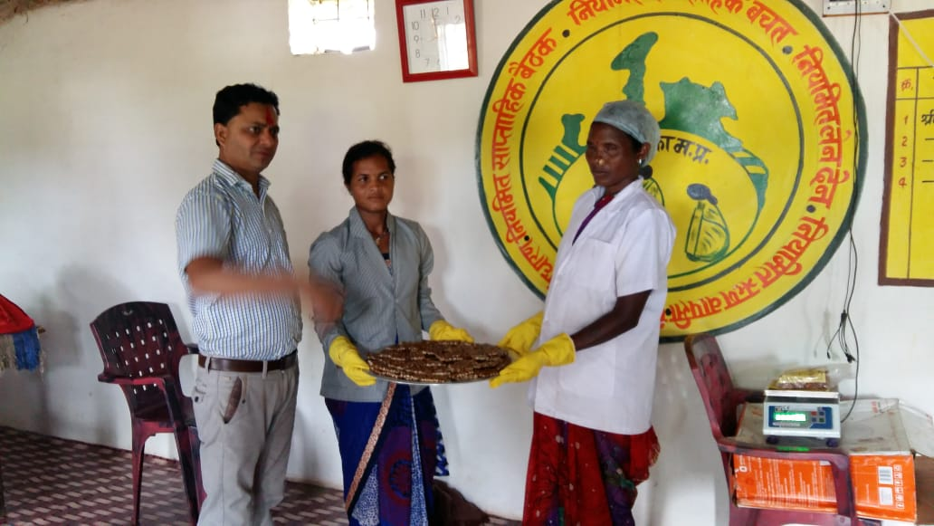
Chikki Making by NRLM SHGs
Government of Madhya Pradesh

Slide 35
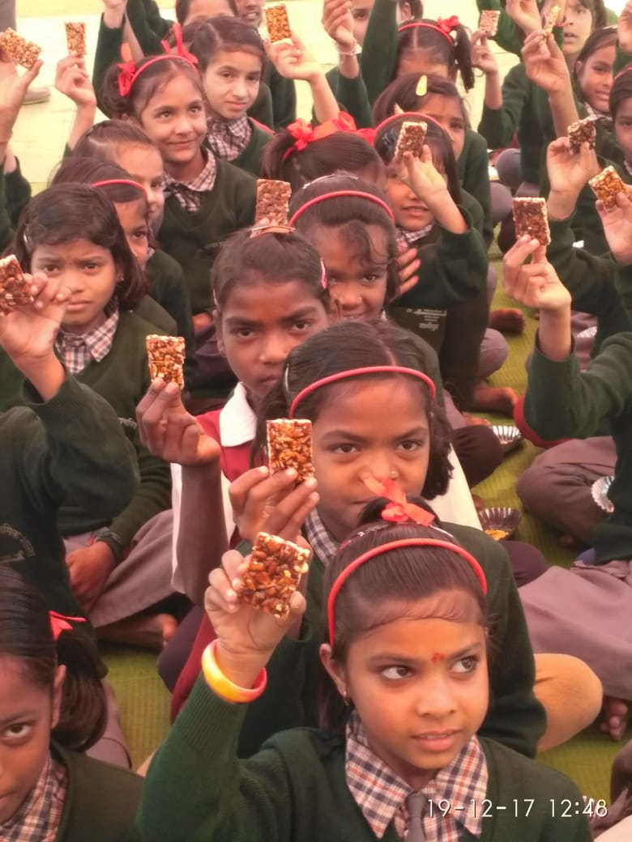
Chikki Distribution
Government of Madhya Pradesh

Slide 36
Kitchen Garden
Government of Madhya Pradesh

Slide 37
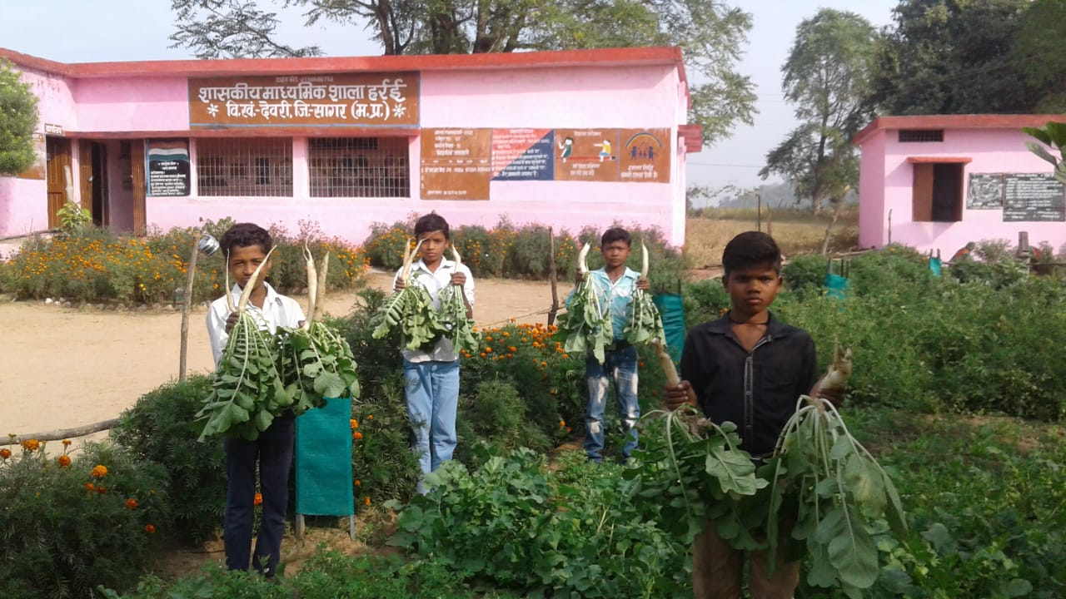
Kitchen Garden in School
Government of Madhya Pradesh
District - Sagar

Slide 38
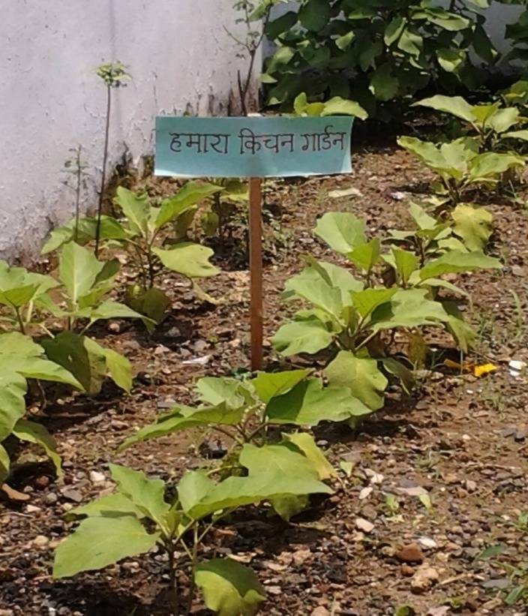
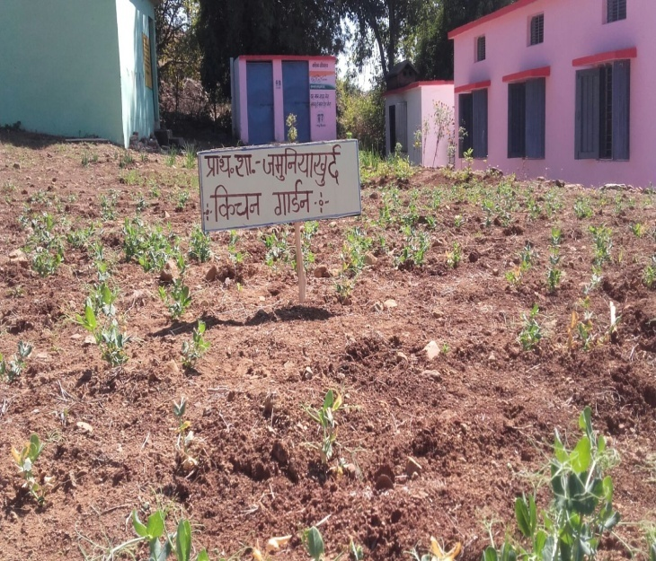
Kitchen Garden in School
Government of Madhya Pradesh
District - Chhindwara

Slide 39
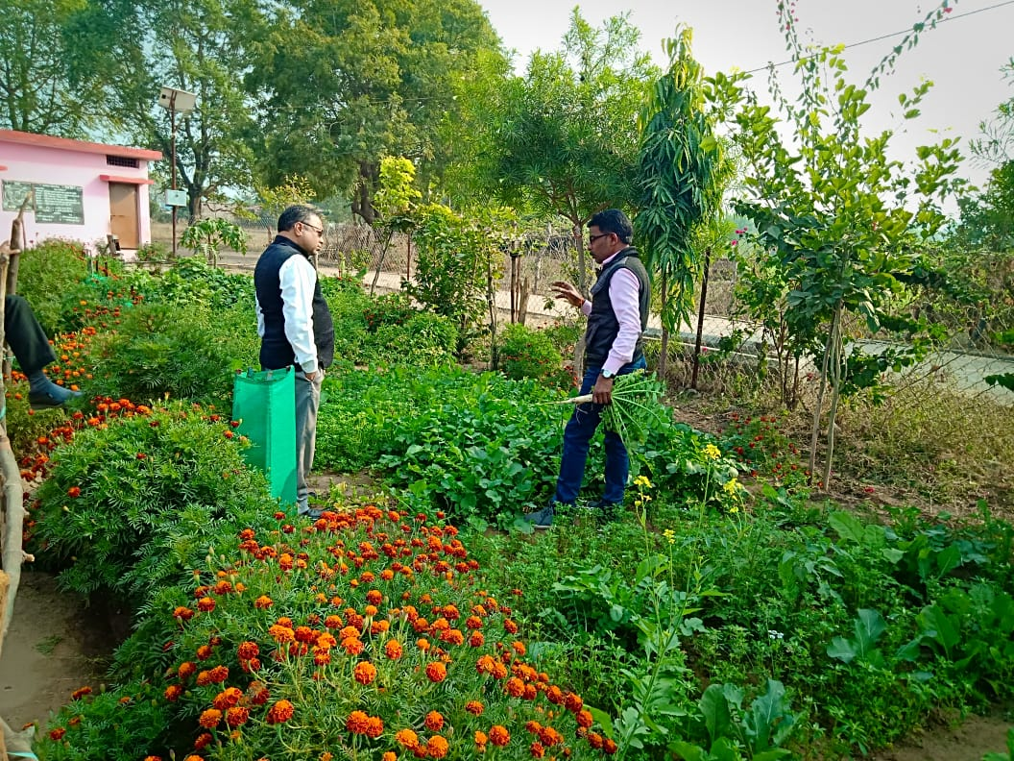
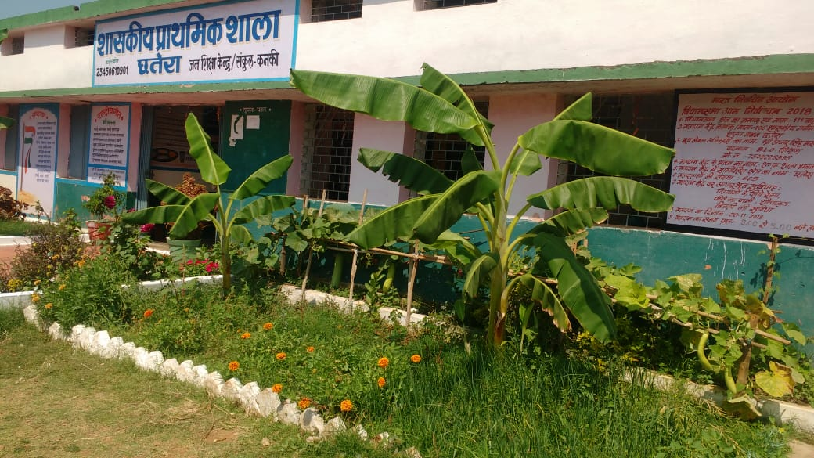
Kitchen Garden in School
Government of Madhya Pradesh
District - Balaghat

Slide 40
LPG GAS CONNECTION
Government of Madhya Pradesh

Slide 41
LPG GAS CONNECTION DISTRIBUTION
Government of Madhya Pradesh
District - Khandwa

Slide 42
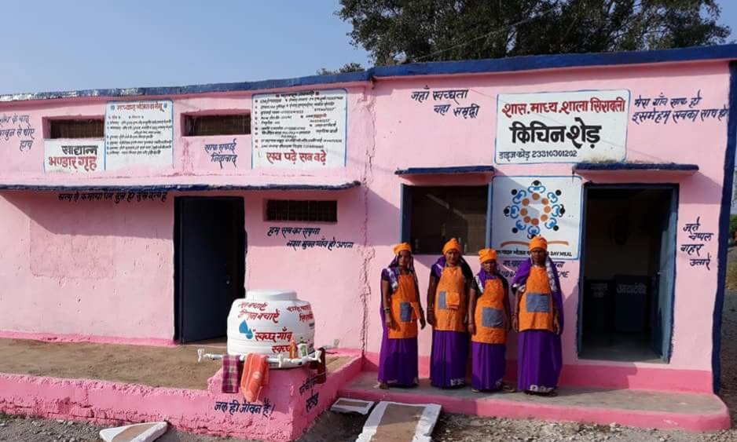
Clean Kitchen Competition
Government of Madhya Pradesh
At the district level, three awards have been given in Clean Kitchen Competition.
First prize – Rs. 50000/- Second prize – Rs.30000/- Third prize - Rs. 20000/-
District - Vidisha

Slide 43
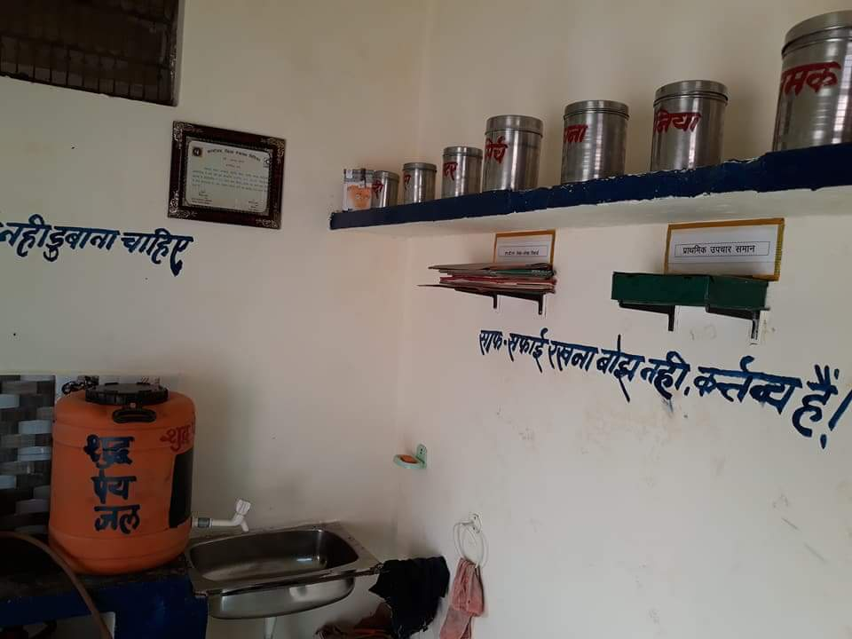
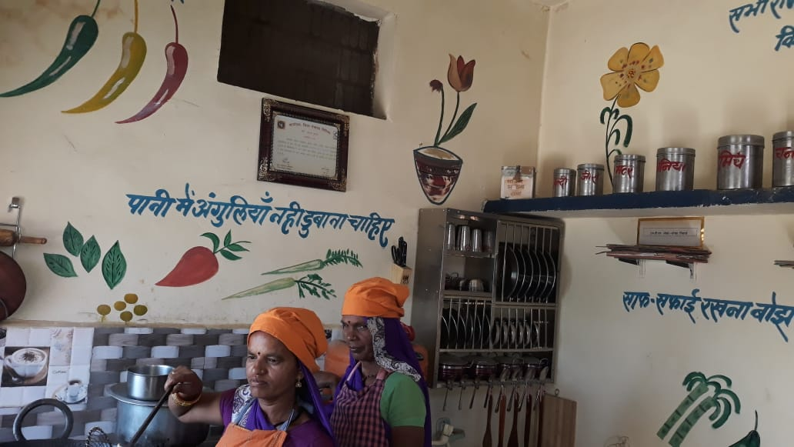
Clean Kitchen Competition
District - Vidisha

Slide 44
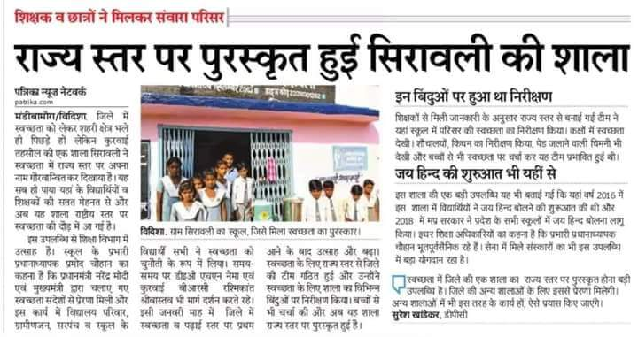
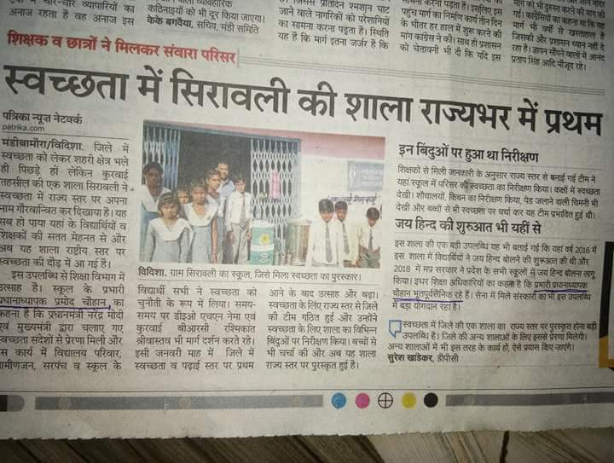
Clean Kitchen Competition
Government of Madhya Pradesh

Slide 45
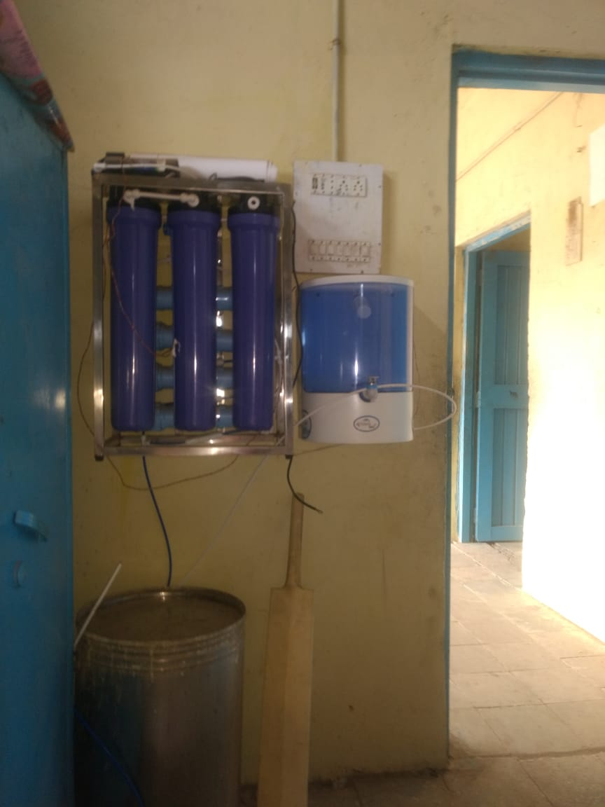
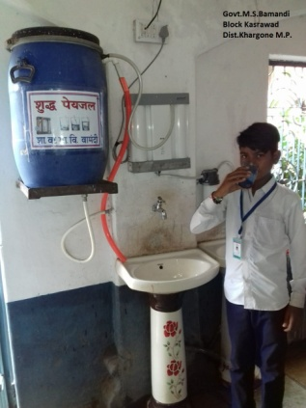
Drinking Water
Government of Madhya Pradesh
District – Sagar and Khargone

Slide 46
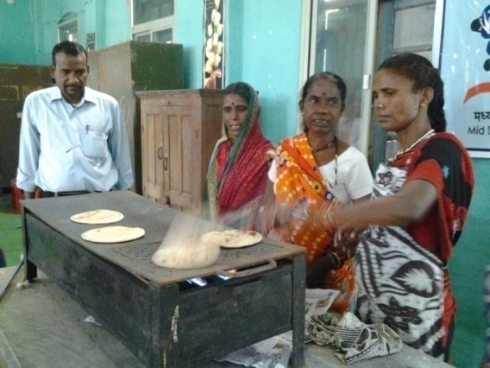
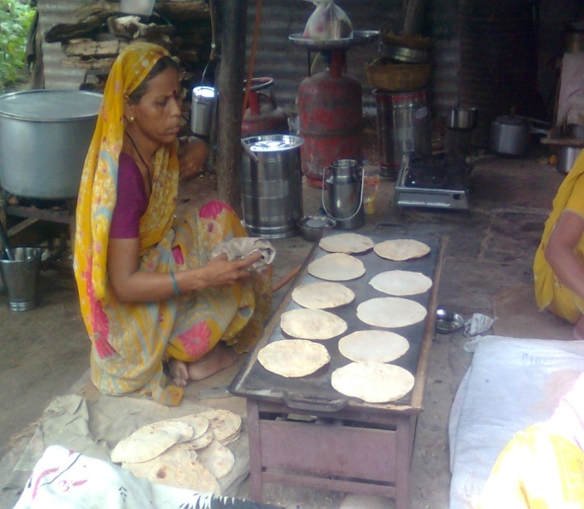
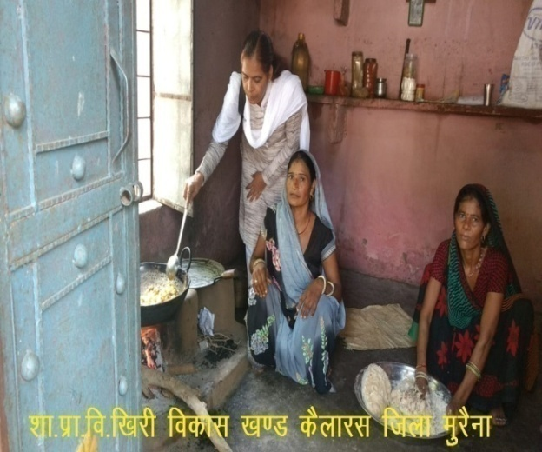
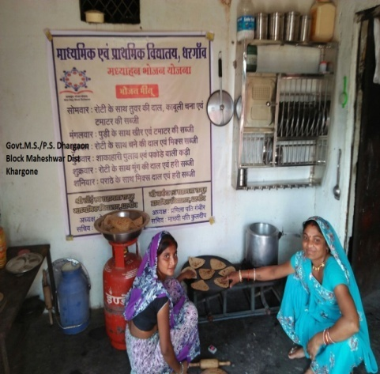
Cooking of MDM
Government of Madhya Pradesh
District - Chhindwara Morena , Burhanpur

Slide 47
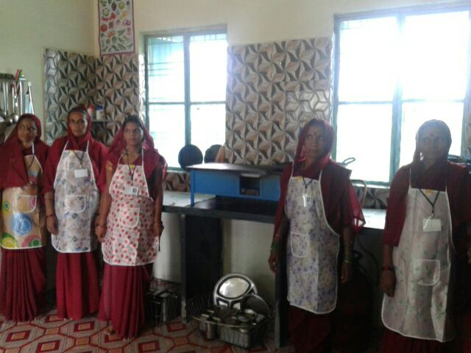
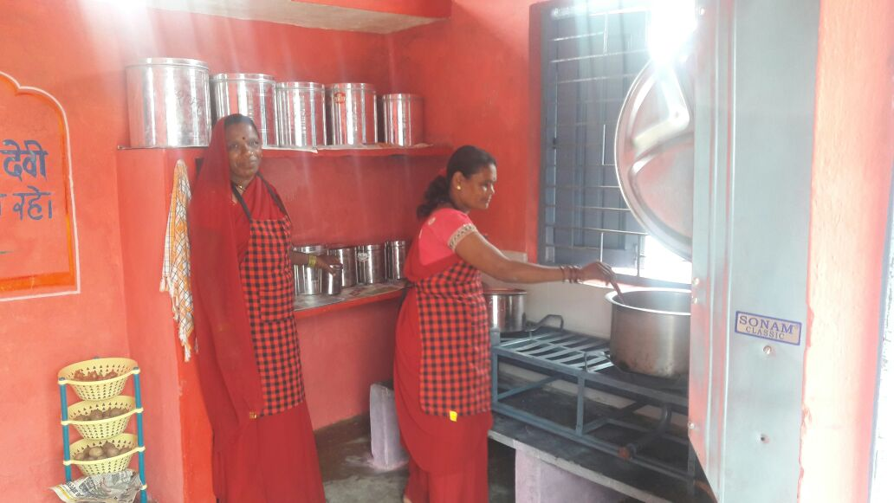
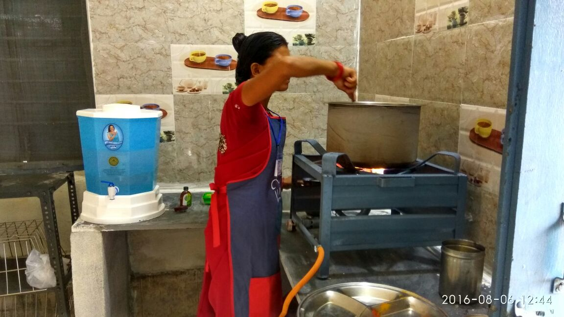
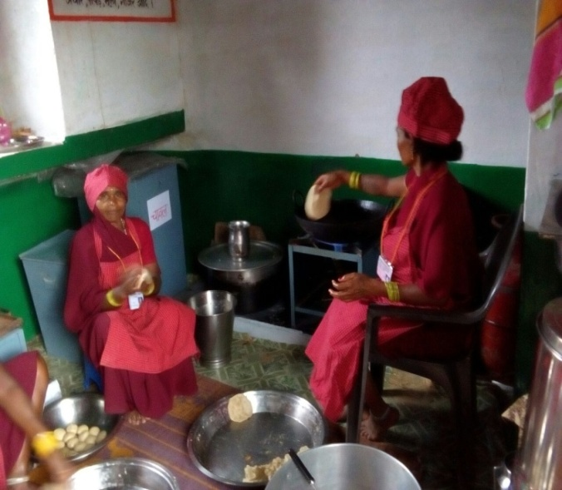
Making food
Government of Madhya Pradesh
District – Chhindwara and Harda

Slide 48
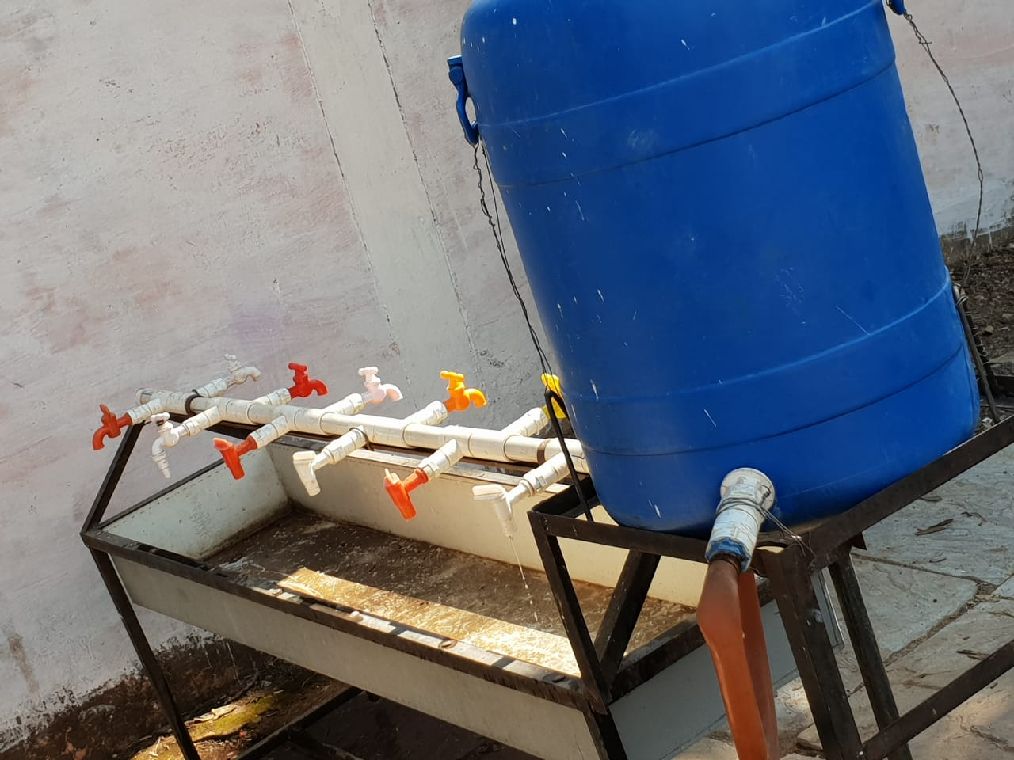
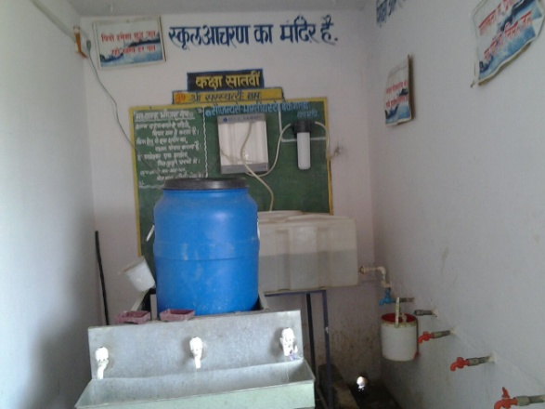
Multi tap Hand wash Unit
Government of Madhya Pradesh

Slide 49
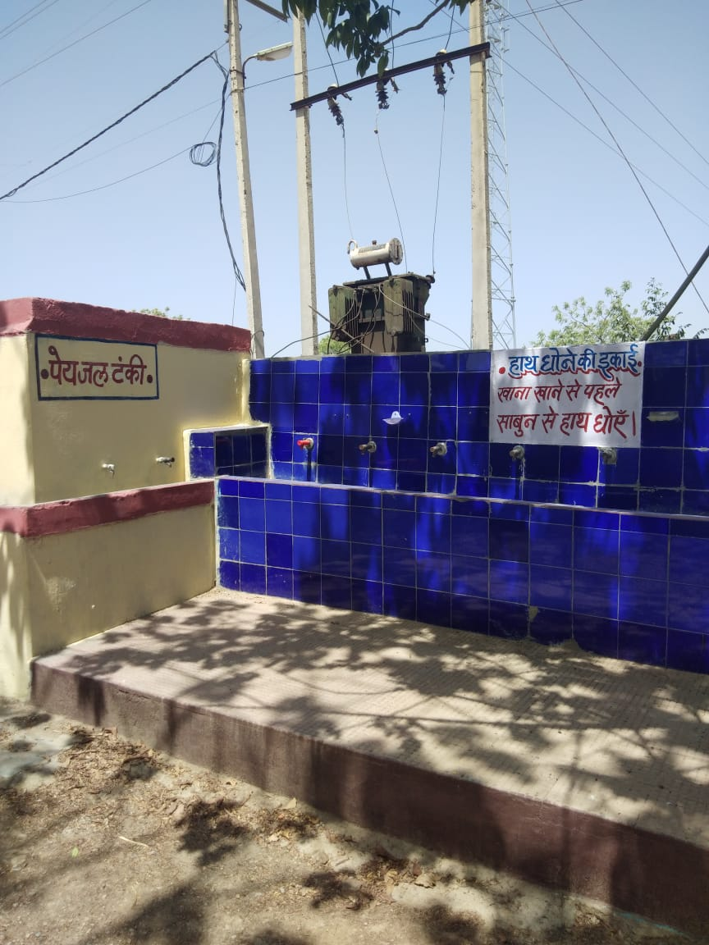
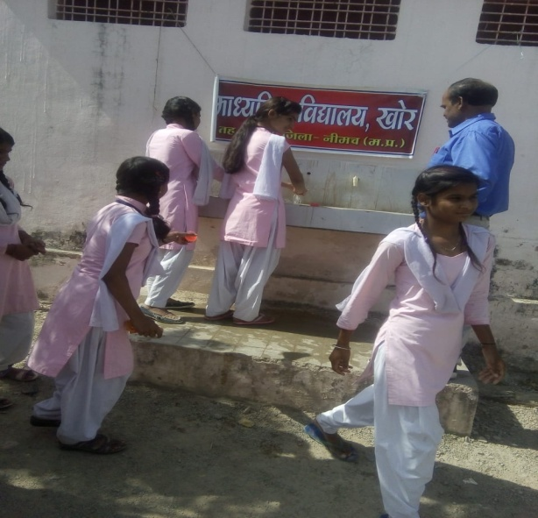
Multi tap Hand wash Unit
Government of Madhya Pradesh
District- Neemuch

Slide 50
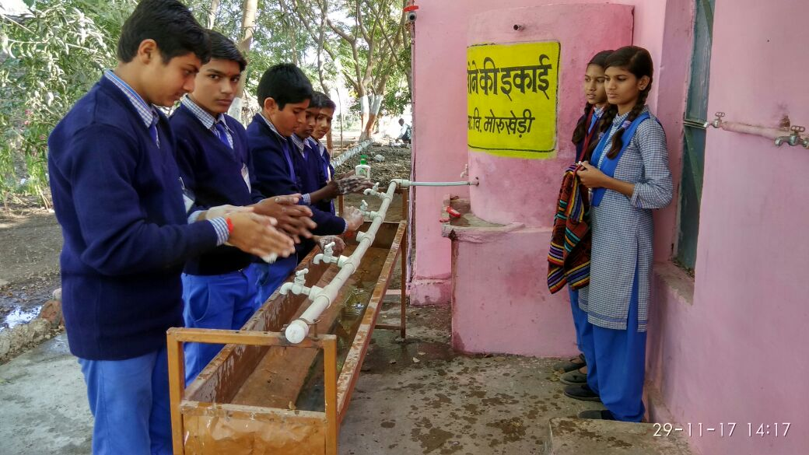
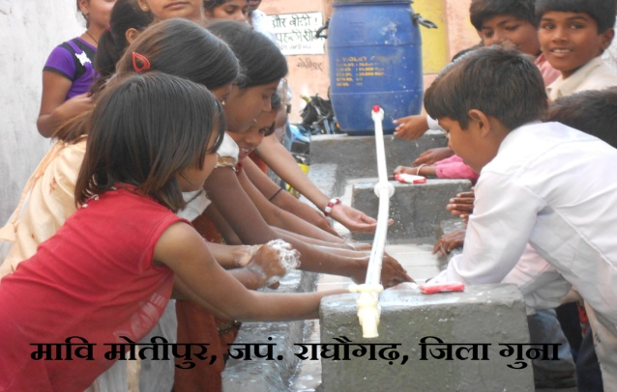
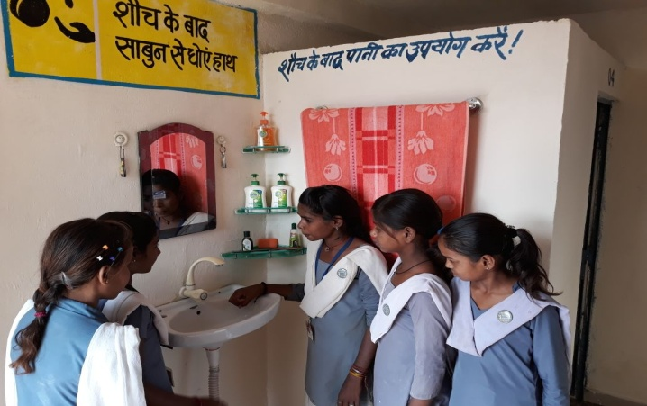
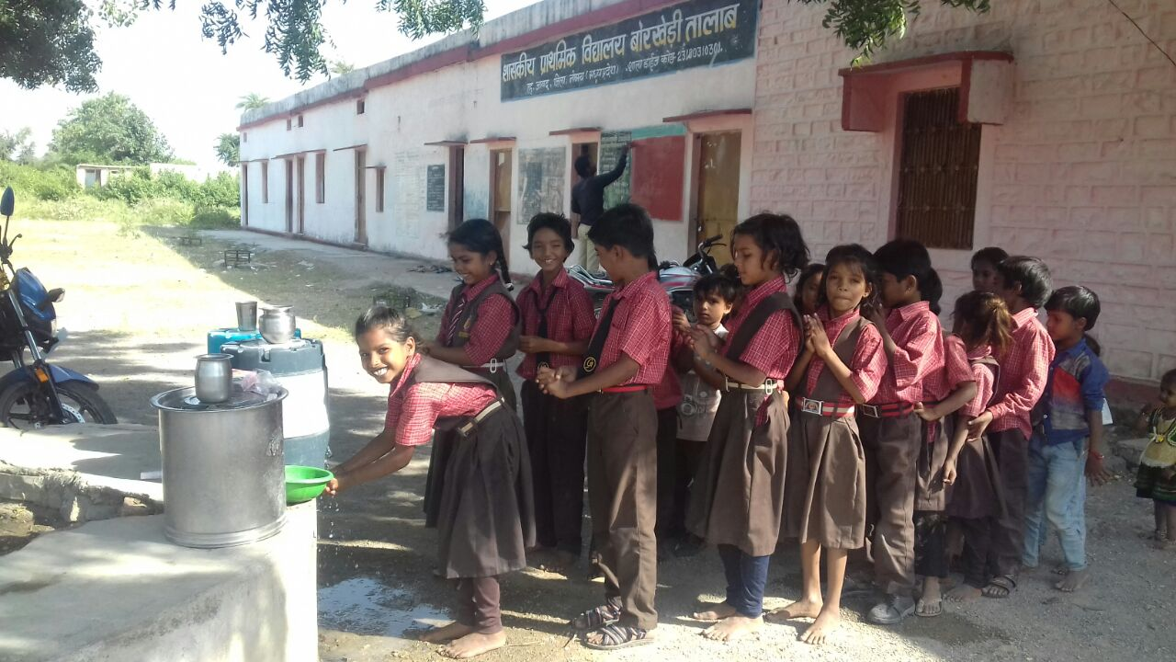
Handwash
Government of Madhya Pradesh
District – Guna, Neemuch and Vidisha

Slide 51


Handwash
Government of Madhya Pradesh
District Datia

Slide 52


Handwash
Government of Madhya Pradesh
District – Dewas and khargone

Slide 53

MDM
Government of Madhya Pradesh
District -Neemuch

Slide 54


Tithi Bhoj
Government of Madhya Pradesh
District –Ujjain

Slide 55

Training of Cook cum helpers
District- Chhindwara

Slide 56


Training of Cook cum helpers
Government of Madhya Pradesh
District- Chhindwara

Slide 57


Milk Distribution
Government of Madhya Pradesh
From 15.07.2015 milk is being served to students of Primary schools and Anganwadis three times a weak (Monday, Wednesday and Friday).
100 ml warm liquid milk prepared out of 10 gm milk powder.
District - Khargone

Slide 58



Milk Distribution
Government of Madhya Pradesh
District – Morena, Mandla and Dhar

Slide 59


Inspection of Milk Distribution by Local MLA
Government of Madhya Pradesh
District -Mandla

Slide 60

Health Checkup
Government of Madhya Pradesh
District -Mandla

Slide 61


Health Checkup
Government of Madhya Pradesh
District -Dewas

Slide 62

Health Checkup
Government of Madhya Pradesh
District -Mandla

Slide 63
Emergency Medical Plan / Contingency plan
Government of Madhya Pradesh
3-Member committee (SDM, CDPO, BRC’s)
Committee will inspect the place within 3 hours and send the report within 24 hours
District Magistrate
Send the report to Head Office, Bhopal within 24 Hrs
State Coordinator (MDM)

Slide 64


Government of Madhya Pradesh
First Aid Box
.
District : Jabalpur

Slide 65
Thank You
Government of Madhya Pradesh

